Slide 1

OGSA Info/Data Model Session
OGF20 - May 9, 2007
Meeting comments and agreements annotated on slides in this color

Slide 2

OGF IPR Policies Apply
“I acknowledge that participation in this meeting is subject to the OGF Intellectual Property Policy.”
Intellectual Property Notices Note Well: All statements related to the activities of the OGF and addressed to the OGF are subject to all provisions of Appendix B of GFD-C.1, which grants to the OGF and its participants certain licenses and rights in such statements. Such statements include verbal statements in OGF meetings, as well as written and electronic communications made at any time or place, which are addressed to:
    the OGF plenary session,
    any OGF working group or portion thereof,
    the OGF Board of Directors, the GFSG, or any member thereof on behalf of the OGF,
    the ADCOM, or any member thereof on behalf of the ADCOM,
    any OGF mailing list, including any group list, or any other list functioning under OGF auspices,
    the OGF Editor or the document authoring and review process
Statements made outside of a OGF meeting, mailing list or other function, that are clearly not intended to be input to an OGF activity, group or function, are not subject to these provisions.
Excerpt from Appendix B of GFD-C.1: ”Where the OGF knows of rights, or claimed rights, the OGF secretariat shall attempt to obtain from the claimant of such rights, a written assurance that upon approval by the GFSG of the relevant OGF document(s), any party will be able to obtain the right to implement, use and distribute the technology or works when implementing, using or distributing technology based upon the specific specification(s) under openly specified, reasonable, non-discriminatory terms. The working group or research group proposing the use of the technology with respect to which the proprietary rights are claimed may assist the OGF secretariat in this effort. The results of this procedure shall not affect advancement of document, except that the GFSG may defer approval where a delay may facilitate the obtaining of such assurances. The results will, however, be recorded by the OGF Secretariat, and made available. The GFSG may also direct that a summary of the results be included in any GFD published containing the specification.”
OGF Intellectual Property Policies are adapted from the IETF Intellectual Property Policies that support the Internet Standards Process.
Notes:
IPR Notices Note Well for OGF meetings

Slide 3
Agenda
Quick overview of models
  GLUE
  BES
  JSDL
OGSA model and use of GLUE

Slide 4
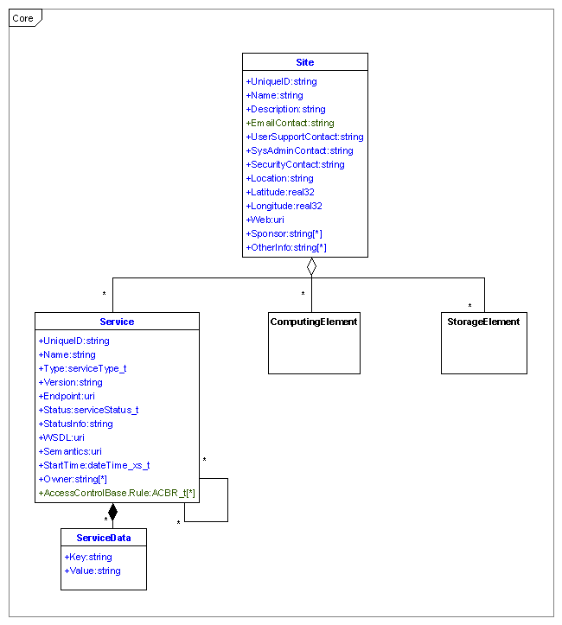
Glue 1.3 Core

Slide 5
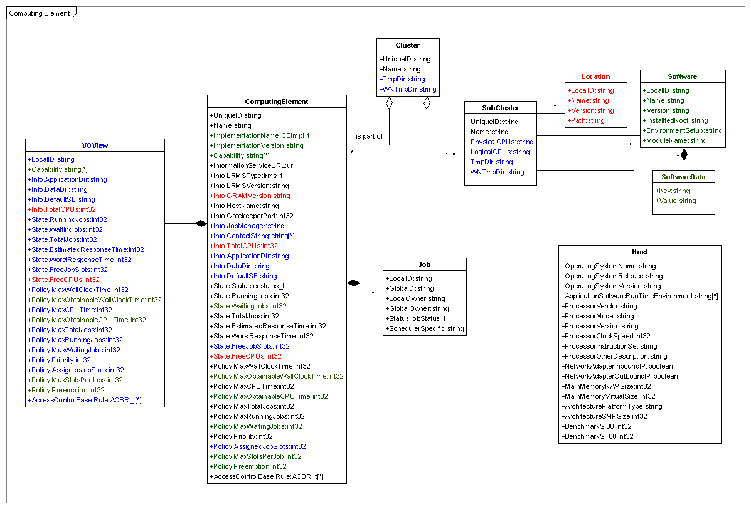
Glue 1.3 Computing Element

Slide 6
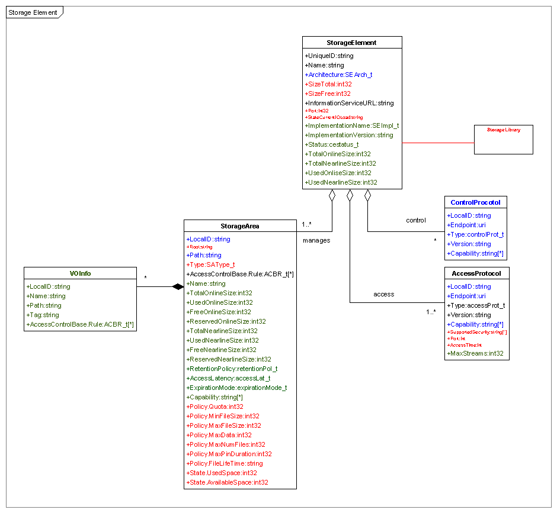
Glue 1.3 Storage Element

Slide 7
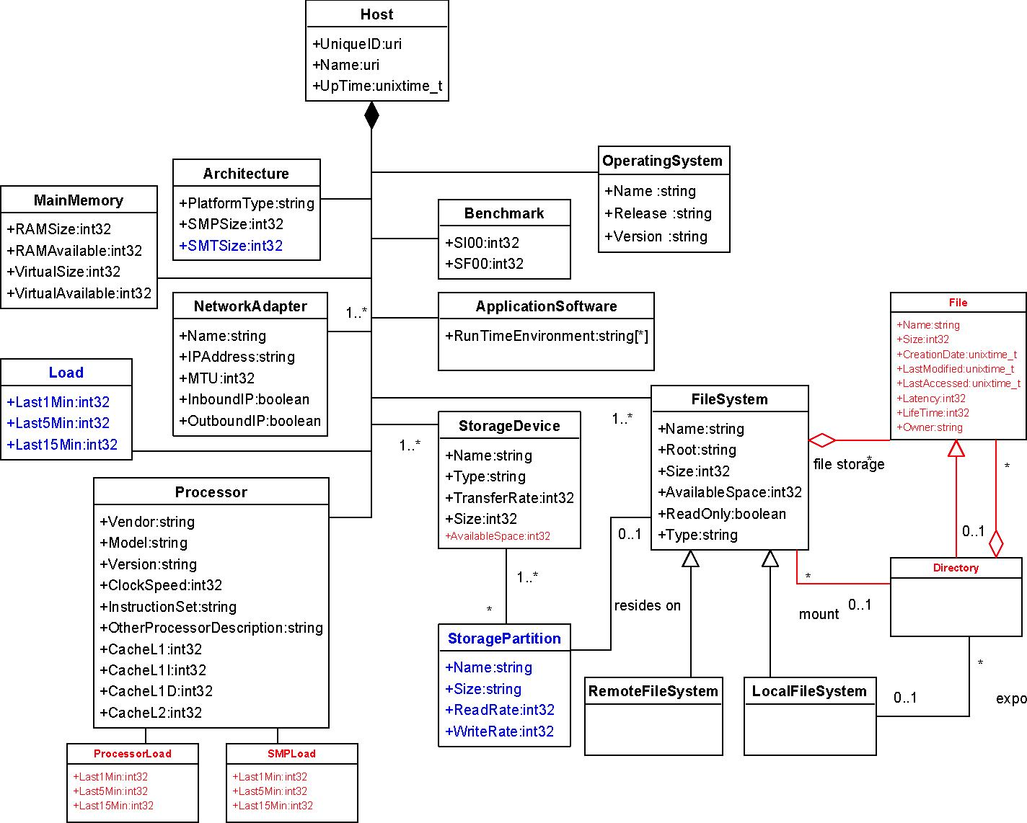
GLUE 1.3 Host Element

Slide 8
BES Attributes
Name | Type | Number | Data Type | Description
IsAcceptingNewActivities | BES | 1 | Boolean | True if BES is accepting new activities
CommonName | BES | 0 or 1 | String | Short human-readable name for BES
LongDescription | BES | 0 or 1 | String | Longer human-readable description.
TotalNumberOfActivities | BES | 1 | Integer | Number of activities current active in BES
ActivityReference | BES | ≥0 | EPR | EPRs to activities currently active in BES
TotalNumberOfContainedResources | BES | 1 | Integer | Number of contained resources accessible by the BES
ContainedResource | BES | ≥0 | anyType | Currently expected to be either of type BasicResourceAttributesDocumentType or FactoryResourceAttributesDocumentType
NamingProfile | BES | ≥1 | URI | URI’s of Naming profiles used by BES
BESExtension | BES | ≥0 | URI | URI’s of supported BES extensions
LocalResourceManagerType | BES | 1 | URI | Resource’s local resource manger type
ResourceName | BR | 0 or 1 | String | Resource’s name
OperatingSystem | BR | 0 or 1 | String | Resource’s operating system type
CPUArchitecture | BR | 0 or 1 | String | Resource’s CPU architecture type
CPUcount | BR | 0 or 1 | Double | Resource’s CPU count
CPUSpeed | BR | 0 or 1 | Double | Resource’s CPU speed, in Hertz
PhysicalMemory | BR | 0 or 1 | Double | Resource’s physical memory, in bytes
VirtualMemory | BR | 0 or 1 | Double | Resource’s virtual memory, in bytes

Slide 9
JSDL – activity requirements (1)
JobIdentification identifies the job | JobName | name of job
 | Description | human readable description
 | JobAnnotation | further info about job that may be used by consuming system
 | JobProject | project to which job belongs, such as for accounting or access control systems)
 | <any other> | extensions
Application describes application and its requirements | ApplicationName | name of application
 | ApplicationVersion | version of application
 | Description | human readable description

Slide 10
JSDL – activity requirements (2)
Resources describes resource requirements of the job | CandidateHosts Hostname | hostname(s) on which to run job
 | FileSystem Name Description MountPoint MountSource DiskSpace FileSystemType <any other> | human readable description local location (filesystem) that must be avail for job remote location avail locally for job range value of amount of disk space (bytes) on containing FilesSystem element for job type of file system of the containing FileSystem element
 | ExclusiveExecution | boolean whether job must have exclusive access to resources
 | OperatingSystem OperatingSystemType OperatingSystemName <any other> OperatingSystemVersion Description <any other> | OS name extension if OS name not in defined list OS version human readable description extensions
 | CPUArchitecture CPUArchitectureName <any other> | CPU architecture required for job execution extension for architectures not defined

Slide 11
JSDL – activity requirements (3)
Resources describes resource requirements of the job | IndividualCPUSpeed | range value of speed (hertz) of each CPU required by job
 | IndividualCPUTime | range value of number of CPU seconds required on each resource to execute the job
 | IndividualCPUCount | range value of number of CPUs to be allocated to the job
 | IndividualNetworkBandwidth | range value of bandwidth requirements (bits/second) of each resource
 | IndividualPhysicalMemory | range value of amount of physical memory (bytes) for each resource allocated to job
 | IndividualVirtualMemory | range value of amount of virtual memory (bytes) for each resource allocated to job
 | IndividualDiskSpace | range value of amount of disk space (bytes) for each resource allocated to job
 | TotalCPUTime | range value of total number of CPU seconds required across all CPUs used to execute job
 | TotalCPUCount | range value of total number of CPUs required for job
 | TotalPhysicalMemory | range value of total amount of physical memory (bytes) for entire job across all resources
 | TotalVirtualMemory | range value of total amount of virtual memory (bytes) for job
 | TotalDiskSpace | range value of total amount of disk space (bytes) that should be allocated to job
 | TotalResourceCount | range value of total number of resources required by job
 | <any other> | extensions

Slide 12
Host
GLUE Class | GLUE Property | Type | Glue Definition | OGSA Proposal
Host | UniqueID | string | opaque, based on DNS entry, global uniqueness
 | Name | int32 | host.domain name
 | UpTime | int32 | seconds since last OS boot time
Host aggregates
  Architecture
  MainMemory
  NetworkAdaptor
  Load (did not examine)
  Processor
  Benchmark
  ApplicationSoftware
  FileSystem
  StorageDevice
  StoragePartition

Slide 13
Architecture
GLUE Class | GLUE Property | Type | Glue Definition | OGSA Proposal
Architecture | PlatformType | string | platform type of the host | specify as enumeration
 | SMPSize | int32 | number of physical CPUs in the host
 | SMTSize | int32 | number of logical CPUs in host
Agreed to use enumeration

Slide 14
MainMemory
GLUE Class | GLUE Property | Type | Glue Definition | OGSA Proposal
MainMemory | RAMSize | int32 | amount of RAM in MB | replace with: TotalPhysicalMemory, int64, in Bytes TotalVirtualMemory, int64, in Bytes
 | RAMAvailable | int32 | amount of free RAM in MB
 | VirtualSize | int32 | amount of virtual memory (RAM+swap) in MB
 | VirtualAvailable | int32 | amount of free virtual memory in MB
RAMAvailable and VirtualAvailable have been removed in GLUE 2.0
There are standards that specify units differences such as megabytes (1000 vs 1024)
GLUE will take under advisement that units for memory & storage should be ‘bytes’

Slide 15
NetworkAdaptor
GLUE Class | GLUE Property | Type | Glue Definition | OGSA Proposal
NetworkAdaptor | Name | string | network adaptor name | replace class with topology class
 | IPAddress | string | assigned IP address
 | MTU | int32 | max transmission unit size for the LAN to which network card is attached
 | OutboundIP | boolean | permission for outbound connectivity
 | InboundIP | boolean | permission for inbound connectivity
Only OutboundIP and InboundIP are in GLUE 2.0
All agree that topology classes are needed, but not a first priority

Slide 16
Processor
GLUE Class | GLUE Property | Type | Glue Definition | OGSA Proposal
Processor | Vendor | string | name of processor vendor
 | Model | string | processor model as defined by vendor
 | Version | string | processor version
 | ClockSpeed | int32 | clock speed in MHz
 | InstructionSet | string | processor instruction set | do enumeration consistent with JSDL & CIM
 | OtherProcessorDescription | string | extra processor info not defined in this class
 | CacheL1 | int32 | first level unified cache size of the processor; not currently used | delete
 | CacheL1I | int32 | first level instruction cache size of the processor; not currently used | delete
 | CacheL1D | int32 | first level data cache size of the processor; not currently used | delete
 | CacheL2 | int32 | second level unified cache size of the processor; not currently used | delete
 |  |  |  | add: Oomph, float, indication of processor power
Cache* properties are removed in GLUE 2.0
Agreed not to add Oomph, but instead use Benchmark properties (next slide)
Agreed to use enumeration

Slide 17
Benchmark
GLUE Class | GLUE Property | Type | Glue Definition | OGSA Proposal
Benchmark | SI00 | int32 | SpecInt2000 | what other benchmarks can be added?
 | SF00 | int32 | SpecFloat2000
no additional benchmarks identified at this time
in the future, application benchmarks may be added

Slide 18
OperatingSystem
GLUE Class | GLUE Property | Type | Glue Definition | OGSA Proposal
OperatingSystem | Name | string | name of OS | do enum consistent with CIM
 | Release | string | release of OS
 | Version | string | version of OS
Additions
  Feature: string, list
  Patch: string, list
Look at CIM Application Model
enum from CIM is outdated – needs to be updated
should use output of uname –a for unix based systems

Slide 19
ApplicationSoftware
GLUE Class | GLUE Property | Type | Glue Definition | OGSA Proposal
ApplicationSoftware | RunTimeEnvironment | string | environment variable associated to installed software pkg | See below
Consider making ApplicationSoftware a freestanding element
Agreed that the application class needs to be allowed to be composed anywhere

Slide 20
StorageDevice, StoragePartition,
FileSystem
GLUE Class | GLUE Property | Type | Glue Definition | OGSA Proposal
StorageDevice | Name | string | name of storage device | replace with a new class that presents a more user-oriented view, for example, and activity requirement to use an Information System
 | Type | string | type of storage device
 | Size | int32 | size of the storage device in MB
 | TransferRate | int32 | maximum transfer rate
 | AvailableSpace | int32 | deprecated
StoragePartition | Name | string | name of storage partition
 | Size | int32 | Mbytes
 | ReadRate | int32 | number Mbytes write per second
 | WriteRate | int32 | number Mbytes read per second
FileSystem | Name | string | name of file partition
 | Root | int32 | path name defining root of file system
 | Size | int32 | size of filesystem in MB
 | AvailableSpace | int32 | available space in filesystem in MB
 | ReadOnly | boolean | read-only or read-write - boolean
 | Type | string | type of filesystem
These not used in GLUE 1.x
Will have focus in 2.0, but not top priority, so need to work on joint proposal
Units should be in ‘bytes’

Slide 21
InfoSystem
Hosts, clusters, sites advertise a list of ‘information’ namespaces names.
These may include, but not limited to
  filesystems
  databases
  document stores
  byteI/O / RNS namespaces
  streaming instruments
Namespace name may include wildcard or perhaps regular expression
For each namespace, include items such as
  r/w indicator
  security
  size
  persistence
  performance
  SLA document
  …
Agreed class(es) for this type of information is needed
Need to work on proposal in conjunction with storage
and file elements on previous chart

Slide 22
Full Copyright Notice
Copyright (C) Open Grid Forum (applicable years). All Rights Reserved.
This document and translations of it may be copied and furnished to others, and derivative works that comment on or otherwise explain it or assist in its implementation may be prepared, copied, published and distributed, in whole or in part, without restriction of any kind, provided that the above copyright notice and this paragraph are included on all such copies and derivative works.
The limited permissions granted above are perpetual and will not be revoked by the OGF or its successors or assignees.
Notes:
OGF Full Copyright Notice if necessary

